Slide 1
ICArUS Pilot Study 1: Facility Identification
Matt Caywood, Brandon Beltz, Michael Fine
April 21, 2011
Distribution restriction:
Information in this document, in whole or in part, cannot be released outside of the ICArUS Program without the prior written permission of the ICArUS Program Manager and Contracting Officer.

Slide 2
Goals
The ICArUS Program will employ a GEOINT-themed Challenge Problem to compare the models’ performance with human performance. This study is designed to address a number of open questions related to the design of the Challenge Problem. In particular,
Can people learn to recognize patterns/select a frame in a high-dimensional feature space?
What types of training – statistical learning, rules etc. - facilitate such learning?

Slide 3
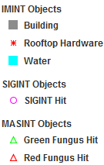
Methods: Data
Three categories of data were associated with the task (IMINT, SIGINT, and MASINT).
IMINT (Image Intelligence): the location and shape of a building, water features, and the presence or absence of rooftop hardware, e.g., a satellite dish.
SIGINT (Signals Intelligence): intelligence gathered by the interception of signals; each ‘hit’ denotes an intercepted signal at that location (e.g., a government-issued cell phone).
MASINT (Measurement and Signature Intelligence): chemical intelligence; each ‘hit’ denotes that a chemical (e.g., green or red fungus) has been detected at that location.

Slide 4
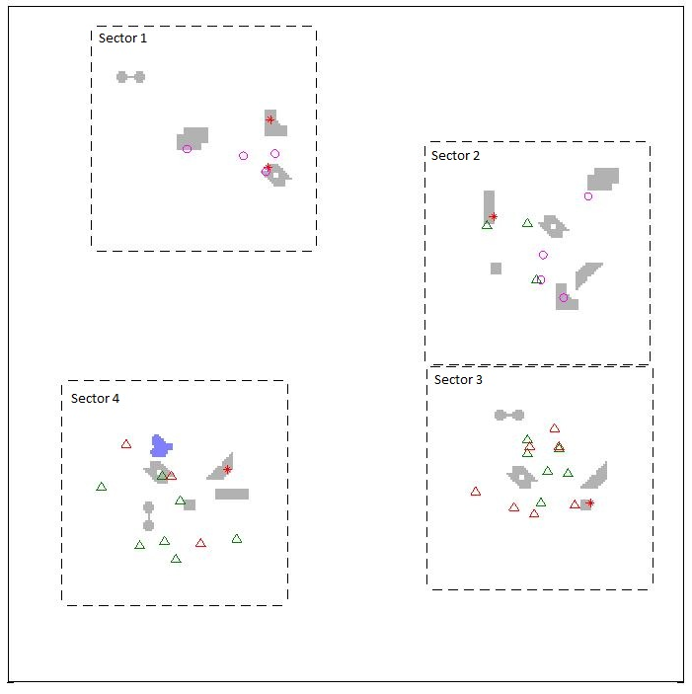
Methods: Facilities
Participants were asked to identify 4 fictitious facilities (Ketchup-, Mustard-, Salt- and Pepper-producing Factories); 2-4 facilities appeared simultaneously in the scene (Figure 4). A facility was comprised of data from each layer.
A scene with 4 facilities.

Slide 5
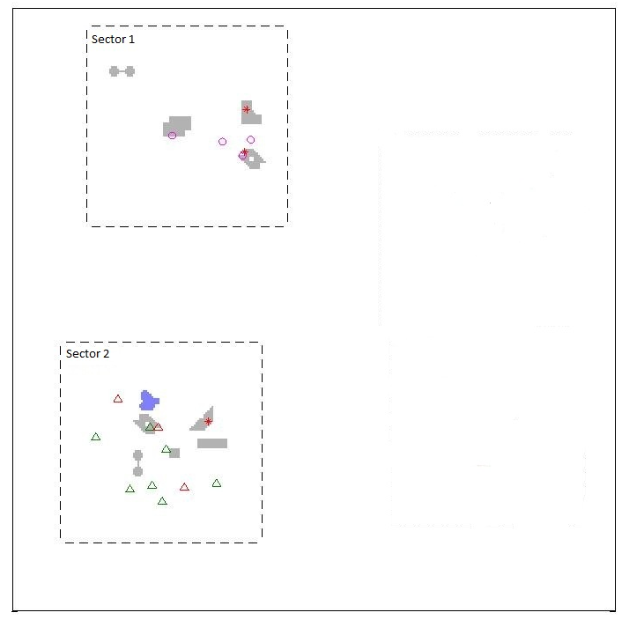
Methods: Questions
The test comprised of a series of multiple-choice questions, and all responses were in the form of likelihoods (e.g., the probability that a particular sector contained a facility). Participants were asked to either:
1. Locate a facility in the scene
2. Identify a facility in a sector
Example scene

Slide 6
Methods: Questions
Data was presented:
simultaneously (all at once)
sequentially (one layer at a time)
or sequentially based on user choice (participants were asked which layer they would like to see next).

Slide 7
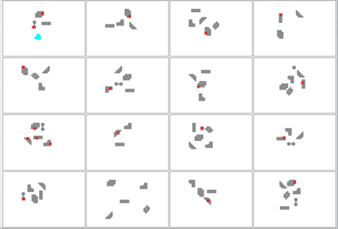
Methods: Training
Participants were trained via statistical learning (partially-annotated examples of each facility) or rules.
Annotation: 48 examples of each facility were presented, 16 at a time.
Training via example (16 instances of a Ketchup Factory shown; IMINT only).

Slide 8
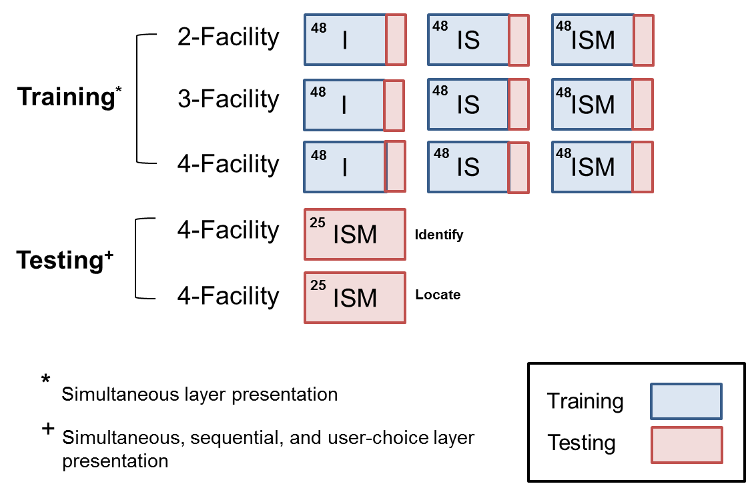
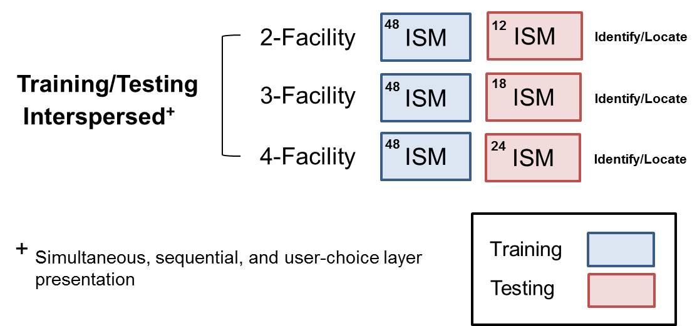
Methods: Structure
Experiment 1
Experiment 2 (Not yet run)
Exp. 1 was divided into 2 sections: training and testing. The number of training examples (training) or questions (testing) is given in the upper-left corner of each box.
In Exp. 2 (not yet run), training and testing were interspersed.

Slide 9
Results: Overview
What was analyzed
Metrics
Subject performance
Subject underconfidence
Subject reports
Future analyses
Notes:
I suggest changing the term “subject underconfidence” to “subject conservatism.” The results show subjects’ underconfidence only for the hypothesis with highest P (i.e., the peak of A%, B%, C%, D%). For the other three hypotheses, subjects are typically overconfident (P too high). This combination of underconfidence (in an H with high P(H)) and overconfidence (in other Hs with low P(H)) is a well-known (since 1950s) phenomenon, discussed at length in Phase 0 paper: “How Humans Forget Frequencies…” The bias is called CONSERVATISM.
The wording here re: “underconfident” is important because the briefing seems inappropriately focused on the one H (A, B, C, or D) with highest P(H). That’s inappropriate because the subjects’ task was NOT to select the H with highest P(H). Instead it was to learn likelihoods P(d|H) and infer posteriors P(H|d), across ALL four hypotheses. This is a major difference between ICArUS research on sensemaking and the large literature on forced choice (e.g., in category learning, reinforcement learning, and other paradigms).

Slide 10
What was analyzed?
Data from 11 subjects (3 team members were also run)
Two final test phases (50 questions)
Identify and Locate questions
Final answer to all question types (Simultaneous, Sequential and User Choice)

Slide 11
Metrics for comparing probability distributions (normative, human, random)
Winner-take-all
Did subject pick most probable facility/sector?
0 when probability curves have same peak; 1 otherwise
KLD (Kullback-Leibler divergence):
Divergence between normative and subject probability curves
In BAA; information theoretic measure
TVD (total variation divergence)
Absolute value distance between normative and subject curves
Potentially more robust to response biases
Notes:
I suggest re-ordering to put KLD first and WTA last. KLD is the standard metric for ICArUS (per BAA), so it should be presented first.
For TVD, the briefing should note that this metric will NOT be used in Phases 1 or 2. If a linear metric is deemed to be better, down the road, then we will use RMS (which is the most common/standard linear metric, albeit not as common as the logarithmic metric KLD). But that’s a BIG if because I’m 95% sure that KLD will be the best metric for our use in Phases 1 and 2. Unlike the pilot study, Phases 1 and 2 will not be dominated by normative solutions that are near {100%, 0%, 0%, 0%}. Ideally the pilot study assessment would also use KLD and RMS, not TVD. I realize this might require re-work, and I suspect it would not change any conclusions so it’s probably not worth doing. Regardless, at the very least this briefing should note that there is no plan to use TVD in Phases 1 or 2.
Re: WTA, I don’t think it really belongs in the briefing – because the stated purpose of the study was to measure how well people can learn, and WTA does not do that at all (see next slide). Worse, WTA is misleading because it suggests that learning was pretty good when in fact learning was pretty bad.
Finally, in all bullets the term “probability curves” should be changed to “probability distributions.” The distributions are discrete (A%, B%, C%, D%) not continuous – and the term “curves” implies continuous.

Slide 12
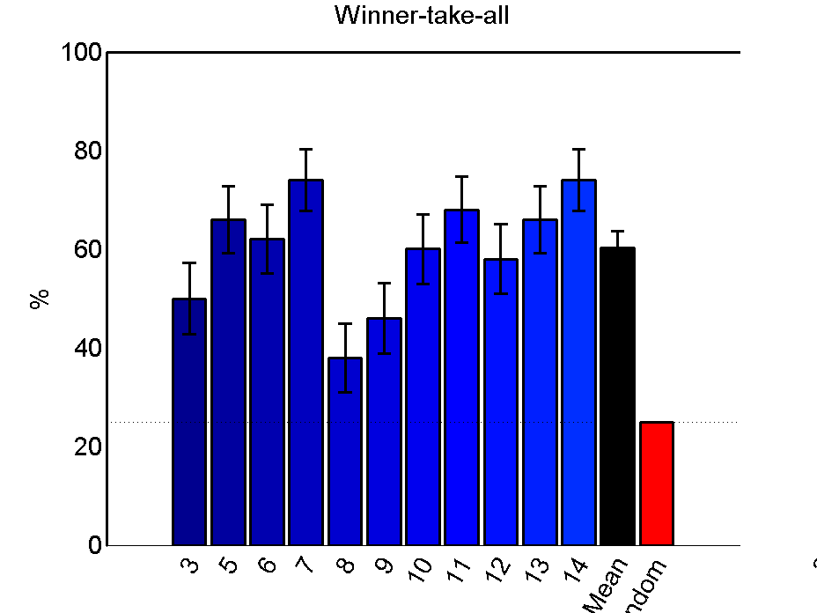
All subjects identified correct facility at above-random rates
error bars SEM
Mean
Random
Subject
Notes:
I recommend that this slide and others re: WTA be downplayed or deleted. The purpose of the study was to measure how well people can learn – relative to random performance (lower limit) and perfect performance (upper limit). With that aim the study requires a measure that applies ACROSS ALL FOUR probabilities in the distribution (A%, B%, C%, D%). WTA does not do that.
For example, say the correct answer is {97%, 1%, 1%, 1%}. Now say a poor subject reports {26%, 25%, 25%, 24%}, and a good subject reports {96%, 2%, 1%, 1%}. Note that the two subjects are at opposite extremes, one near the lower limit (near random) and the other near the upper limit (near perfect). And yet they both get the same score (full credit!) by WTA. This is an esp. a bad thing for MITRE to do in our role of T&E, as we will be setting ourselves up for exploitation by performers later in Phases 1 and 2…
For example, let’s assume a performer has a poor model (as described above) of human performance – i.e., the model usually gets the same peak H (A, B, C, or D) as humans but the model’s distribution (across A, B, C, D) is very far from the human results. Well this performer would love to argue that his model is good, using WTA. So how do we tell the performer that his model is bad (which it is) when our own metric (in pilot study) would say the model is good?

Slide 13
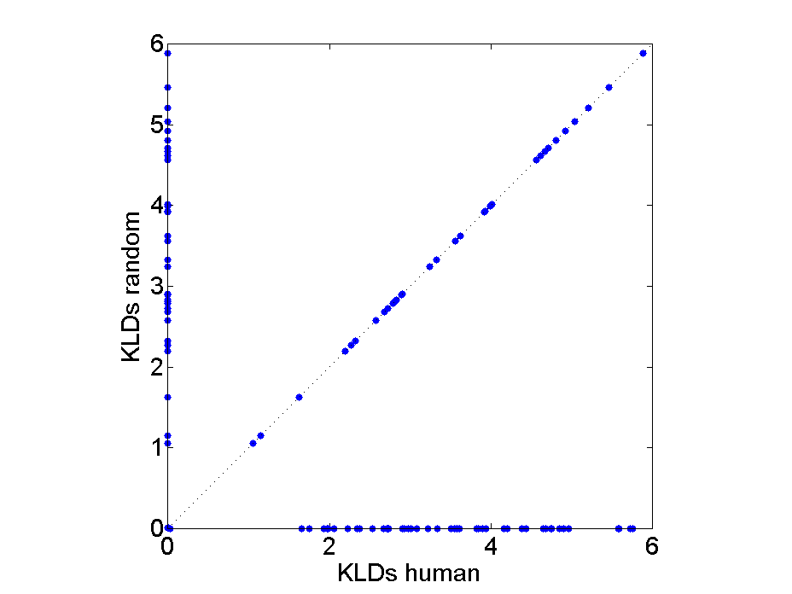
Evaluating subject performance using KLD/TVD metrics
Normative
Compare
Human divergence from normative, to
Random model divergence from normative
Above/left of diagonal → subject exceeds random performance
Each point = 1 question
A
B
C
D
Random
Perfect
A
B
C
D
A
B
C
D
Wrong
A
B
C
D
Notes:
FWIW I don’t understand the blue points on this graph, or the placement of red bar plots. Maybe it’s more clear with the soundtrack.

Slide 14
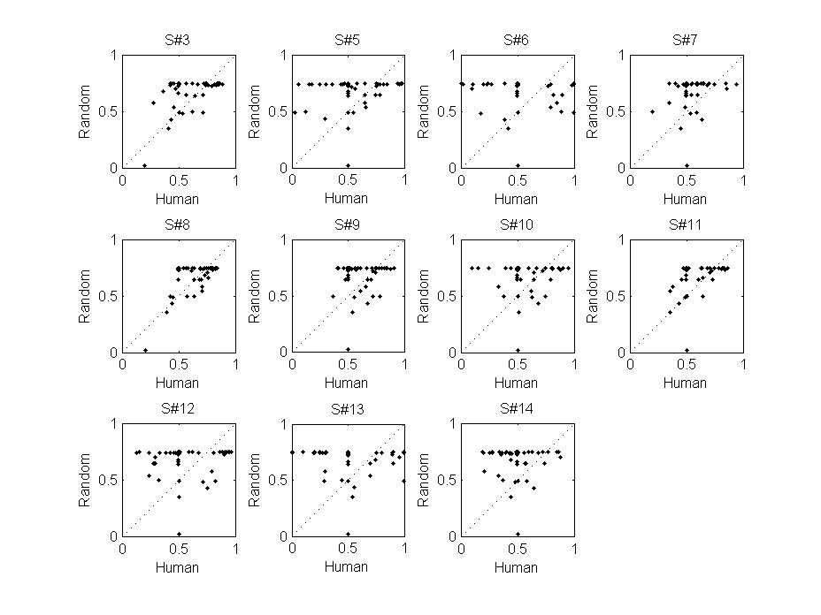
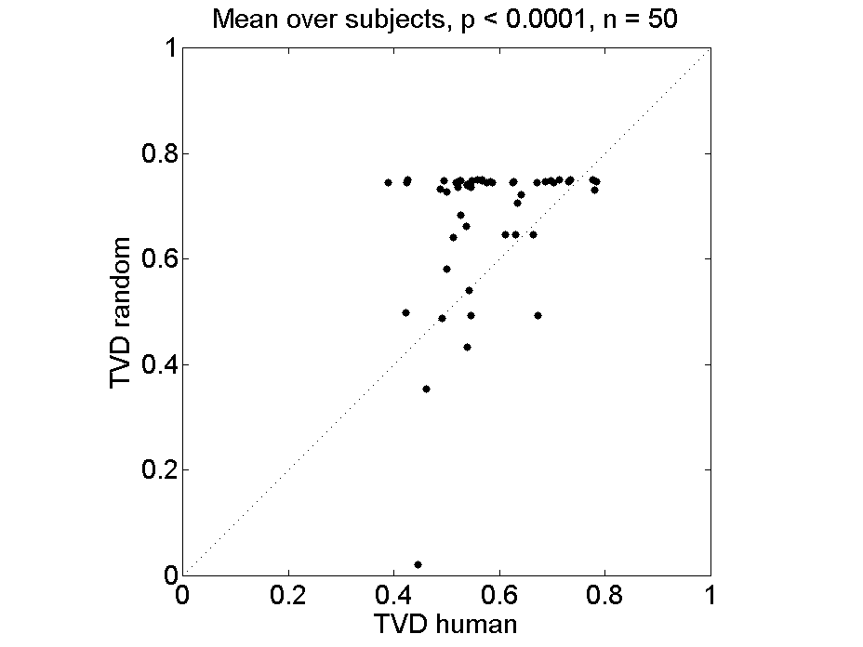
Subject group learned (by TVD analysis)
Performance better than random with p < 0.0001
Notes:
As noted earlier, “better than random” is not a useful measure of performance. Assuming the experiment is not purposely deceptive, then on average subjects should ALWAYS (on all trials) do better than random (although some individuals may not). That’s why random is a lower bound, at least for studies of sensemaking without “denial and deception” (which are outside the scope of ICArUS). Saying that performance is “better than random” is like saying it’s “somewhere between the ground (random) and the sky (perfect).” The p < 0.0001 means only that we can (per TVD) be very confident in rejecting the null hypothesis and hence in saying performance is not on the ground. But that gives no insight into the magnitude of learning, or the conditions (e.g., classes of stimuli) that lead to various levels of learning between the ground and the sky.
WRT the metric TVD itself, the briefing should give an equation so readers know how TVD is computed.
These plots show a ceiling effect, which is not discussed (perhaps because it doesn’t support the favored conclusion?). That is, most of the data have TVD_random = 75%. I’m not sure how TVD is computed (see above), but the ceiling suggests that maybe the correct answer on all the ceiling trials was near {100%, 0%, 0%, 0%}. In that case ANY ANSWER (by a human) that is slightly higher for the peak H relative to other Hs will produce TVD_human > TVD_random. In other words, for most of the data (which lies on the ceiling) TVD gives the same answer as WTA! Moreover, these data points (with TVD_random pegged at 75%) are the ones causing human > random performance on average over the set of points. If we eliminate the ceiling points, well then TVD shows results that look a lot like those from KLD – i.e., human performance no better than random performance. [Note that Phase 0 avoided ceiling effects, and the plan is also to do so going forward in Phases 1 and 2. This makes the issue of KLD vs. RMS (or TVD) a non-issue for T&E in Phases 1 and 2.]

Slide 15
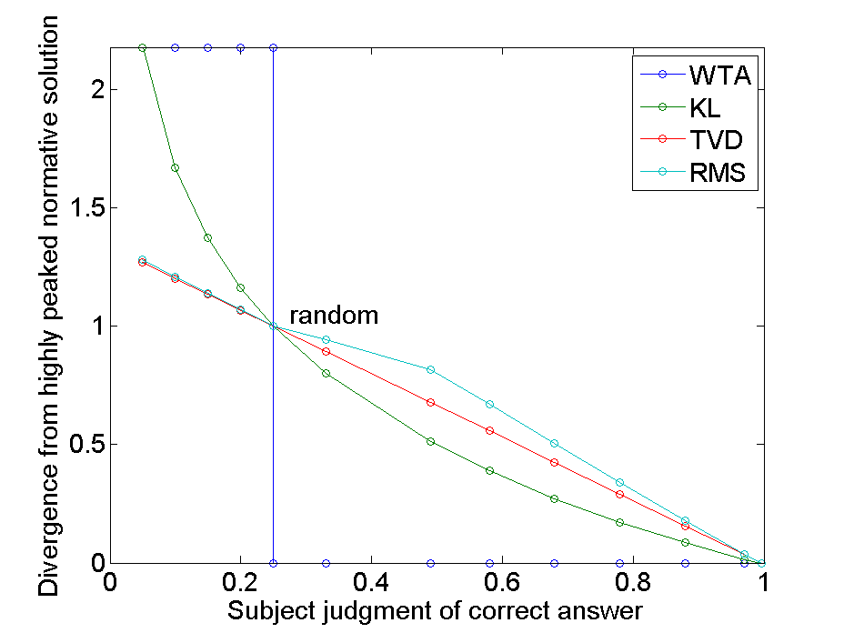
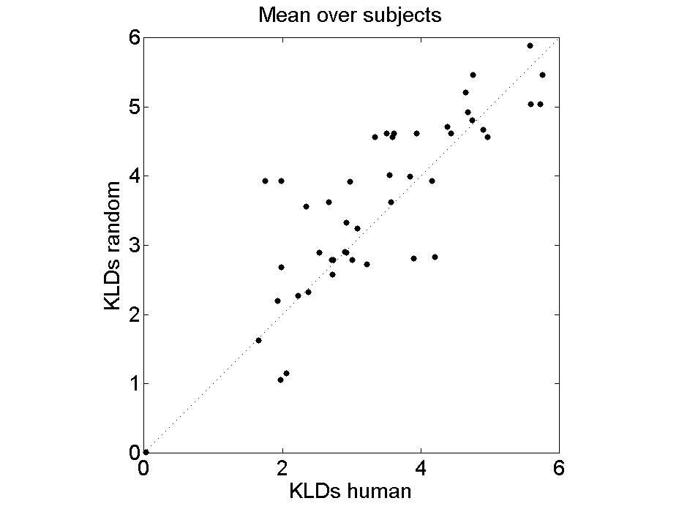
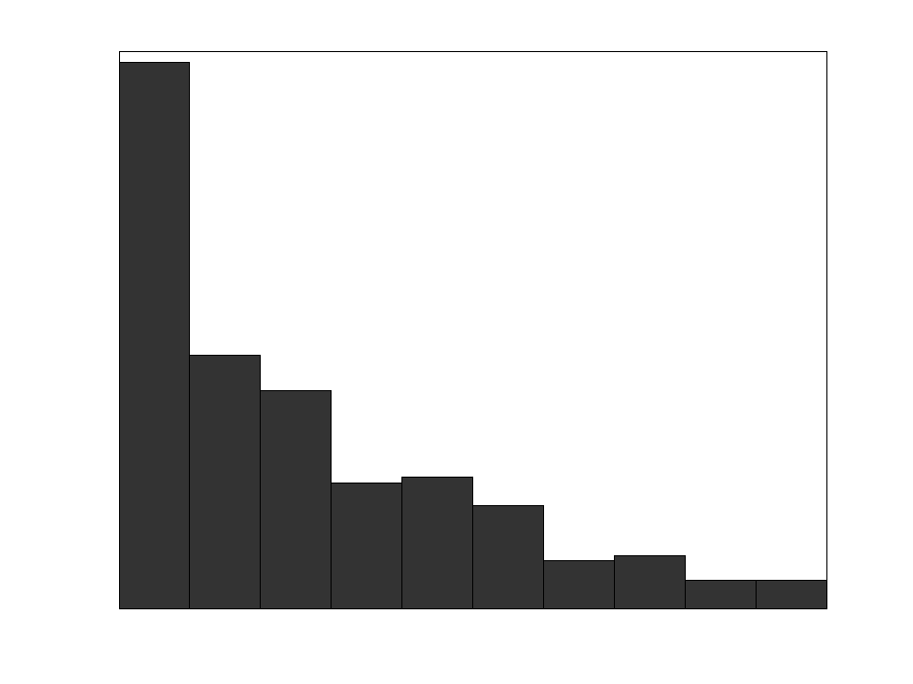
KLD did not show learning
Problems with KLD in pilot study
Subject mistakes are greatly exaggerated
Problem worse when solutions very peaked (as they were in pilot study)
mistaken
underconfident
correct
Observed subject judgments in pilot study
Notes:
Please reconsider the wording of this slide. I do NOT agree that there are “problems with KLD.” Instead the problems are with the design of the stimuli and use of TVD. Apparently the data are dominated by very peaked (normative) distributions that produce a ceiling effect when performance is measured with TVD. Another problem is that subjects did not learn because they were overwhelmed, as noted in the later slide on working memory. Both of these problems stem from experimental design, not computational metrics.
Subjects’ mistakes were NOT “greatly exaggerated” by KLD. Instead subject’s responses were merely measured by KLD, which is the standard metric for comparing the information divergence between two probability distributions. The exaggerations come from WTA and TVD, which say something like the following: “If the task is to learn a distribution {100%, 0%, 0%, 0%}, then any response where A% is greater than B%, C%, and D% will be considered good performance – even if A% was barely higher than B%, C%, and D%.”

Slide 16
KL divergence & the BAA
BAA: “model’s confidence distribution will be compared to that of humans using a metric such as the Kullback-Leibler divergence…the T&E Team may explore other metrics”
CPA team is systematically investigating metrics
For final assessment, BAA requires “success rate in matching human performance” of 50%, 65%, 80% in Phases 1, 2 and 3.
Does not specify how metrics should be transformed to success rates
Will be calibrated in future according to subject & computational model performance
Notes:
Please delete this slide. It has nothing to do with the pilot study. Also, to the extent that the pilot study ran into problems using KLD, the problems stem from the experimental design – not from the computational metrics themselves. In short, the problem lies in CPD not in CPA. That’s why CPD (not CPA) is my number one priority at this point.

Slide 17
Subject confidence
Subjects frequently made correct identifications
However, several subjects reported that they did not think “probabilistically” and that reporting their answers in percentages was challenging
Most subjects moved probability sliders less than optimal amount
Some subjects did not feel confident about answers
Some subjects may have ignored the effects of normalization on final judgment
e.g. only adjusting the slider corresponding to the ‘most probable’ facility
At least one believed that answers were ~80/20 on account of test asking about probabilities
(See example on next slide)
Notes:
The first bullet is a vacuous statement. The purpose of the study was not to make identifications. Instead the purpose was to report confidence across a set of hypotheses, and the results show that on average people performed at levels barely (or not at all) above chance.

Slide 18
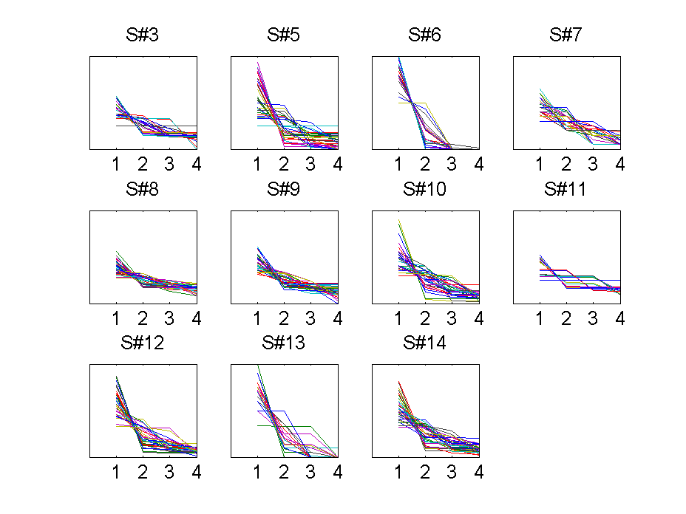
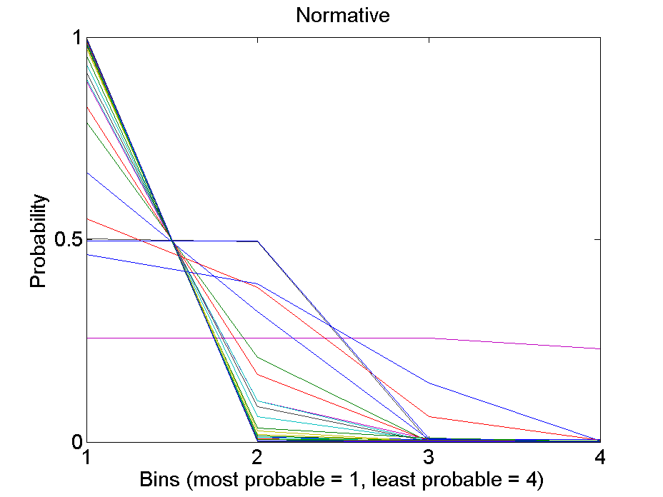
Subject judgments were underconfident relative to normative solution
Rank-order probability curves
3
2
4
1
1
2
3
4
1
2
3
4
A
B
C
D
1 line = 1 trial
Notes:
Please see comment on slide 9, re: saying “conservative” rather than “underconfident.”
This slide (or a new one) might mention that the pilot findings are consistent with the main result of the Phase 0 learning study (Tasks 1 and 2). In the paper (“How Humans Forget Frequencies…”), Phase 0 went further to develop a descriptive model (with one free parameter) and then fit the model to subjects’ data (N = 85). The free parameter was a discounting factor, which ranged from 0 (no learning) to 1 (perfect learning). On average, d was always < 1, which means that subjects were conservative.
As I suggested in earlier conversations and emails to the T&E team (some months ago), the same model could be used to assess learning/inference performance in the pilot study. That is, average responses (across subjects) on each trial could be fit to get the value of the discount parameter d. The average of all trials would give an overall measure of performance, in the range of d = 0 (no learning) to d = 1 (perfect learning). The variation in d across trials would be a rough measure of difficulty – i.e., low d (high discounting) would suggest that the problem (posed by stimuli on that trial) was more difficult than for a trial with high d.

Slide 19
Subject reports of learning difficulties
Memory limits a big issue!
Subjects reported using about 3-5 different rules or strategies to identify facilities.
e.g. “If red and green triangles, then mustard. Circles plus no water, then ketchup. Plus others I can't remember.”
e.g. “The chemicals were the most consistent. none = ketchup, both = mustard, green = salt, red = pepper”
All subjects reported that they forgot some of the rules they developed over the course of the experiment.
Several reported that it was very difficult to learn the facilities due to the lack of feedback.
Notes:
This slide presents what I think is most interesting finding from the experiment. It says that subjects were trying to extract and exploit rules (i.e., if-then likelihoods), of the sort that are needed for sensemaking – as opposed to just doing implicit pattern matching without rules.
Also interesting (but not unexpected) is that people say they can only handle ~4 things (e.g., rules) at a time. There’s a large literature on this limitation (see Cowan, 2000, “The magical number 4 in short-term memory…”). The limit was considered in design of the Phase 0 experiment, and is also being carried forward in CPD for Phase 1. Apparently pilot subjects were overwhelmed by demands on working memory, and I think that explains their overall poor performance in learning/inference. This is no surprise based on the Phase 0 results. I still don’t understand why anyone (at IARPA or MITRE) expected that learning of many more likelihoods would be easier.

Slide 20
Subject feedback: Opinions about the overall study
Question | Average Response (Scale)*
1. I think the study instructions were easy to understand. | 3.4
2. I think the study test questions were easy to understand. | 3.6
3. I think the study test questions were easy to answer. | 2.4
4. I think it was easy to use the computer software during the study. | 3.6
5. I think it was easy to input my answers using the probability sliders in the study. | 3.0
6. I felt like I was engaged or having fun during the study. | 2.2
7. I felt like I was interested in the study. | 2.9
8. I felt bored throughout the study. | 2.4
9. I felt tired throughout the study. | 3.3
*Response Scale
Strongly Disagree (1) | Disagree (2) | Neutral (3) | Agree (4) | Strongly Agree (5)

Slide 21
Future analyses
Specific facility identification
Were subjects better at identifying facilities they trained on earlier?
Was performance predicted by training time?
Learning of specific scene features / INTs
Data from assessment questions
Was performance predicted by training time on INTs?
Question difficulty
Facilities more or less typical of category
One peaked answer vs. multiple valid answers
Question type analyses
Did answers in sequential questions approach normative?
Were subject INT choices optimal?
Did subjects respond similarly to same scene queried with different question types?
Notes:
Given the overall poor performance and lack of engagement, I’m not sure the data warrant “future analysis.” None of the questions listed here seems very interesting or important to me. For example, given the lack of learning (knowledge) I suspect that “subjects’ INT choices” would not tell us much – simply because the subjects did not have much if any basis for a choice (i.e., they did not learn much of anything).
Instead of this list it would be nice to see just one or two specific questions, along with an explanation of why they are important for moving forward in Phase 1. That might help Brad decide when and how to wrap up this work. Maybe he even has his own ideas about what more thing(s) he might like to see?
FWIW the only thing I’d like to see going forward is something along the lines of what I mentioned earlier in notes to slide 18. That is, it would be nice to have a rough (descriptive) model that tells us how much (on average) the human responses were discounted (d) relative to perfect responses. This would do three things to bring the study to a head, as follows:
First it would highlight CONSERVATISM (discounting) as the main bias found in the pilot study (much like the Phase 0 learning study). [Note that this bias is not mentioned in BAA. Note also that the same bias might be characterized as a form of “anchoring and adjustment,” where the anchor is the initial (uniform, uninformative) distribution.] Conservatism is the OPPOSITE of Confirmation Bias (in weighing of evidence), because Confirmation Bias would produce cognitive distributions that are more peaked (not less peaked) compared to normative distributions.
Second, the model would provide a useful measure of performance (d), ranging from 0 (zero learning) to 1 (perfect learning). This would give us a much better measure of performance than just saying it was “better than random” (>0) or not.
Finally, the average d on each trial would enable comparison between trials. For example, treating d as the dependent variable, further analysis could regress d (for trial 1, 2, 3, etc.) onto various independent variables (for trial 1, 2, 3, etc.) to see if there are interesting correlations – i.e., to see what independent variables might (?) be driving differences in the level of discounting (d).

Slide 22
Backup

Slide 23
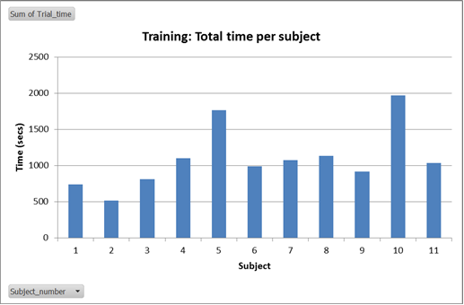
Subjects attended to training over time
Average time spent training: 18 min (range 8.5 – 33 min)
Subjects sped up (time per phase) through training

Slide 24
Experiment 1: Detailed Structure
Experiment 1, Testing (Set 19 and 20)
Defined next slide…

Slide 25
Structure Key
Question {Identify, Locate}
The type of question.
Target {A, B, C, D}
The target facility (Identify/Locate Facility A).
Presentation {Simultaneous, Sequential, Choice}
The data was presented ‘simultaneously’ (all at once), ‘sequentially’ (one layer at a time), or ‘sequentially based on user choice’ (participants were asked which layer they would like to see next).
Order
Simultaneous {ISM}
IMINT (I), SIGINT (S), and MASINT (M) were presented simultaneously.
Sequential {I-S-M, I-M-S}
Choice {I-SM}
IMINT was presented first. Users could choose to see SIGINT or MASINT.
Scene {1-16}
Scene number. Multiple questions were asked per scene.

